Slide 1
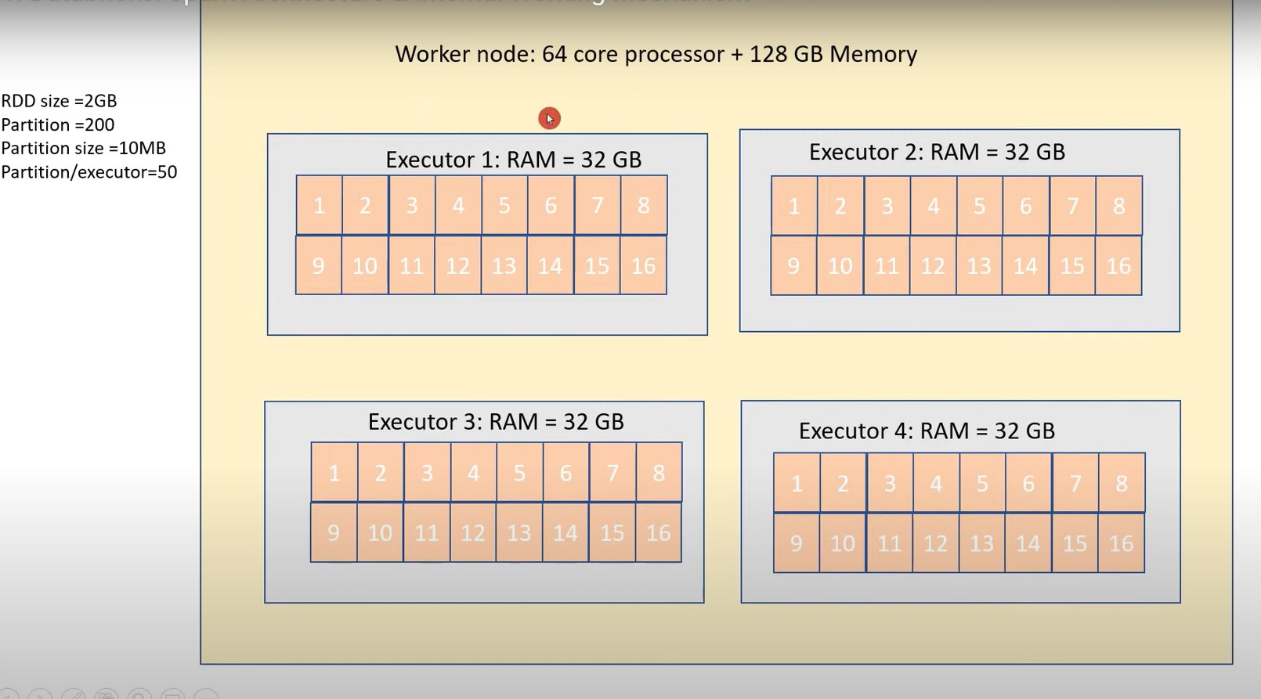

Slide 2
CPU
Parallelization
Core
Thread
Vcpu
SLOT

Slide 3
Scaling
Vertical Scaling
Horizontal Scaling

Slide 4
Spark
Runs Everywhere
Unified platform
In memory-cluster computing framework

Slide 5
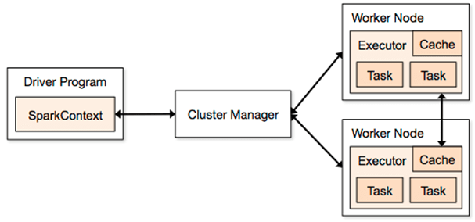

Slide 6
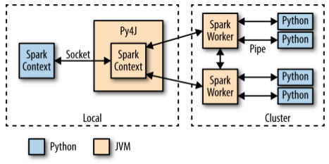

Slide 7
Introduction to PySpark
Python API for Apache Spark
Allows Python developers to harness the power of distributed computing

Slide 8
Why PySpark?
Big data processing at scale
Distributed computing with fault tolerance
Integrates with Hadoop, Hive, HDFS, Delta Lake, etc.
High-level APIs (DataFrame, SQL) + low-level (RDD)

Slide 9
PySpark Architecture Overview
Spark Core
Handles job scheduling, task dispatching, memory management, fault recovery
Spark Components
Spark SQL, Spark Streaming, MLlib, GraphX
Driver Program vs Executor
Driver: Sends tasks
Executors: Do the actual work

Slide 10
Driver Program
Spark Context
Cluster manager
Worker Nodes
Executors (JVM)
Task / Slots

Slide 11
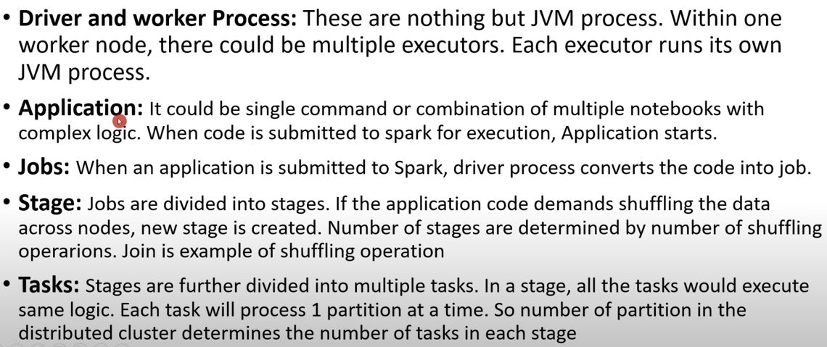

Slide 12
User Session
Spark Context → RDD
Spark Session
------------------
Spark Context
SQL context
Hive Context
Streaming Context

Slide 13
Lazy evaluation
Transformation
Narrow Transformation
Wide Transformation

Slide 14
Shuffles
Joins
Group By key
Reduce by key
Re-partition

Slide 15
Actions
Take
Top
Collect
Max
Min
Stats

Slide 16
Persisting / Caching
GC
Disk spill/slow

Slide 17
Joins
Safe joins
Sort merge
Both files are large
Shared Variables

Slide 18
Shared Variables
Broadcasting → Show a read only data from the smaller file to larger file
Accumulators → Implement counters

Slide 19
RDD vs DF VS Dataset(only for Scala & Java)
RDD → Low level API
=====
Distributed collection
Immutable
Fault tolerant
Lazy evaluations
Scala, Java, R, Python
Unstructured data
Disadvantage
Doesn’t infer schema, optimization of code is manual

Slide 20
DF
Distributed Collection of Row objects
Optimization → Catalyst Optimizer (Tungsten)
Hive compatibility
Java, Scala, Python, R
Infer schema, it gives structure of the data
Compile time safety

Slide 21
Cluster Manager
Standalone, YARN, Mesos, Kubernetes
DAG (Directed Acyclic Graph) vs Execution Plan

Slide 22
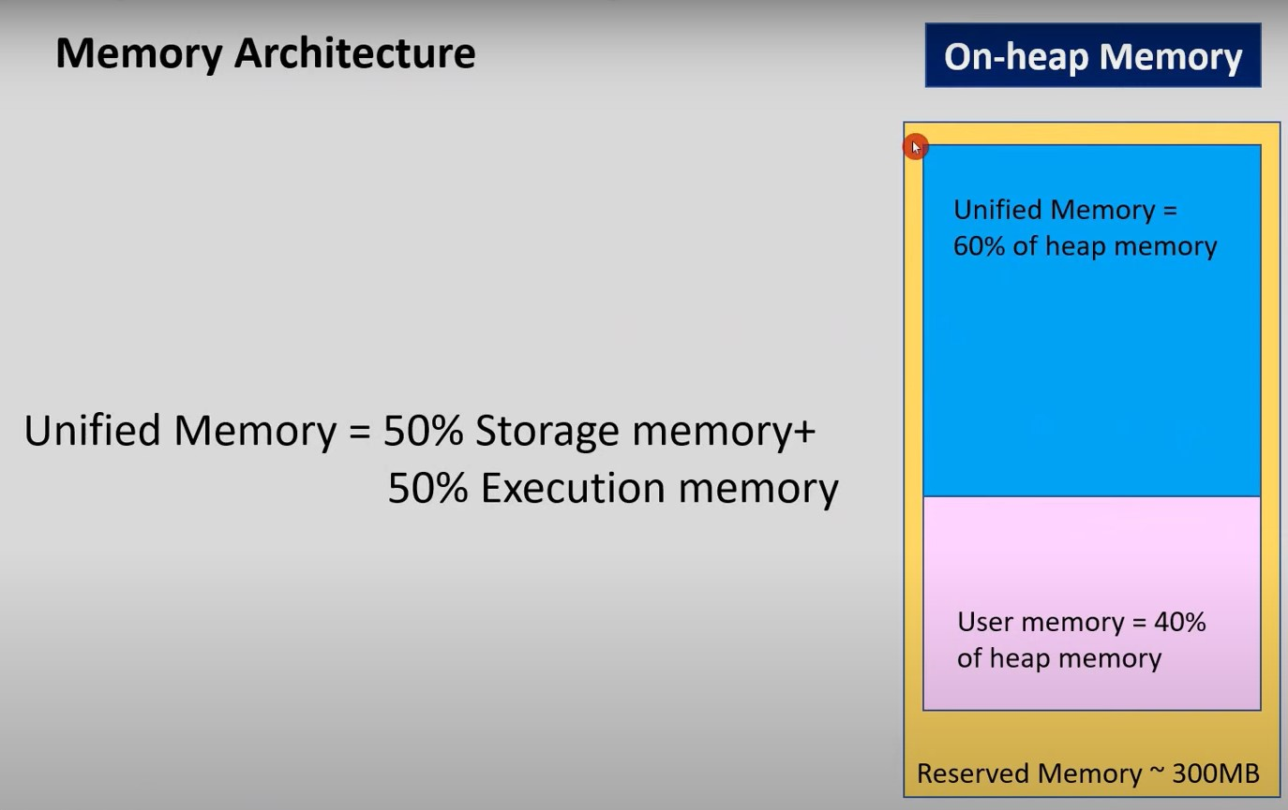

Slide 23
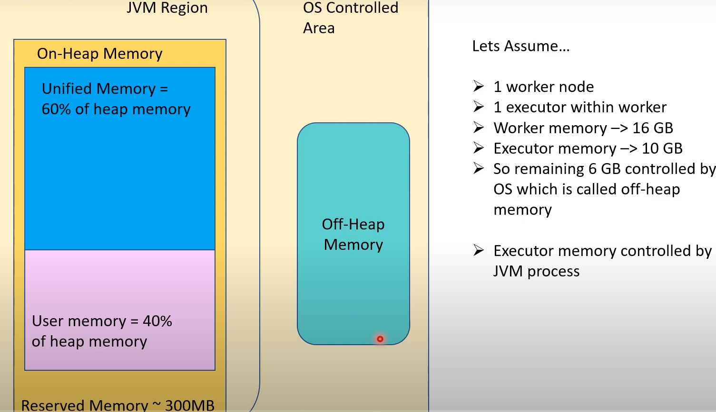

Slide 24
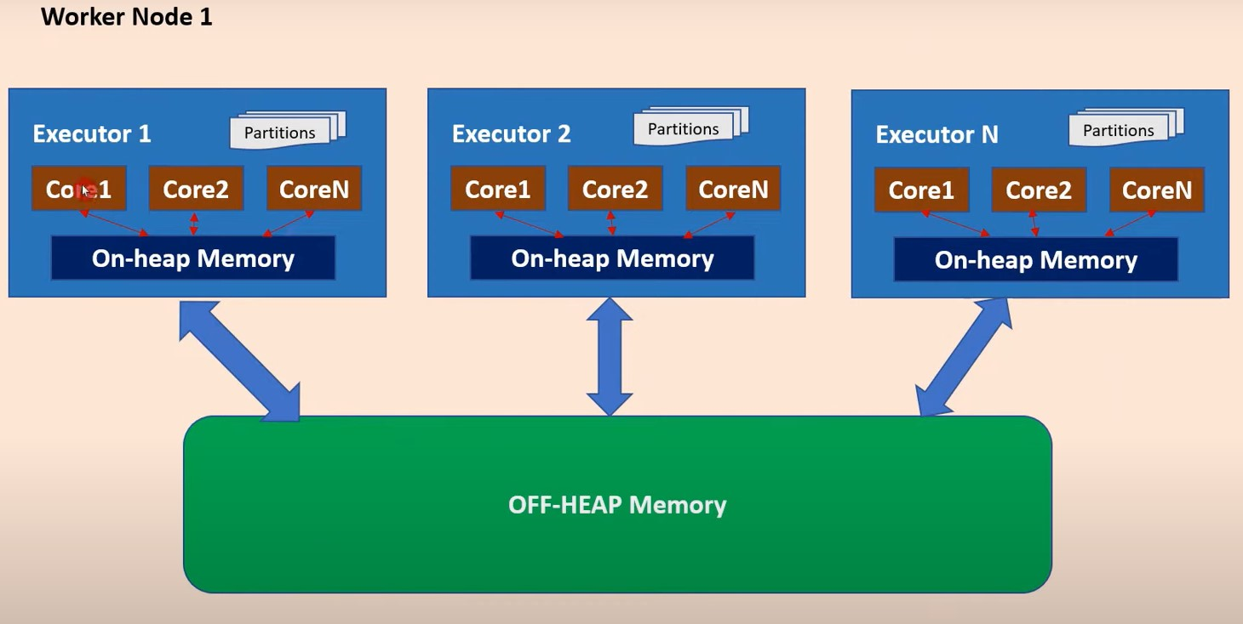

Slide 25
Why Memory Management Matters in Spark
Spark is designed to handle large-scale, in-memory computations.
Efficient memory management = fewer shuffles, faster processing, less GC overhead.
Spark applications run on JVM, so JVM memory management rules (including garbage collection) apply.

Slide 26
What is Garbage Collection (GC)?
Garbage Collection is the JVM’s automatic process of reclaiming memory occupied by objects no longer in use, freeing up space for new object allocations.

Slide 27
How does GC work?
GC runs in phases, inspecting the heap to identify "unreachable" objects:
Young Generation GC (Minor GC): Fast but frequent. Cleans short-lived objects.
Old Generation GC (Major/Full GC): Slower, for long-lived objects.
GC pauses can freeze executors, causing delays or task failures.

Slide 28
PySpark Memory Management
a. Importance of Memory in Spark
Efficient memory usage directly impacts performance
Type | Description
On-heap memory | Managed by JVM; includes object storage, RDDs, task data
Off-heap memory | Outside JVM (direct memory); used for storage caching, Tungsten optimizations
On-Heap stores data in deserialized format → good for computation.
Off-Heap uses serialized binary formats → saves space, avoids GC.

Slide 29
Assume, --executor-memory 16g
JVM Memory: On-Heap vs Off-Heap
Type | Managed By | Use Cases | GC Affected
On-Heap | JVM (GC) | Code execution, caching, shuffles | ✅ Yes
Off-Heap | Spark/Tungsten | Binary formats, unsafe caching, I/O buffers | ❌ No

Slide 30
Spark Unified Memory Management (On-Heap)
spark.memory.fraction = 0.6 # 60% of on-heap memory
spark.memory.storageFraction = 0.5

Slide 31
If executor memory = 16g:
Component | Allocation
Unified Memory (60%) | 9.6g
▸ Execution Memory (50%) | 4.8g
▸ Storage Memory (50%) | 4.8g
Remaining JVM Memory (40%) | 6.4g

Slide 32
Execution Memory – used for:
Shuffles, joins, aggregations Storage Memory – used for:
cache(), persist(), broadcast variables
Remaining 6.4g is used by:
Internal Spark needs
Broadcast joins
Garbage Collection (GC)
Off-Heap Memory in Spark

Slide 33
Off-Heap Memory in Spark
spark.memory.offHeap.enabled=true
spark.memory.offHeap.size=4g
Advantages:
Not controlled by JVM GC
More predictable, stable memory for I/O buffers, columnar caching
Used heavily in Tungsten execution engine (Catalyst + Tungsten project)

Slide 34
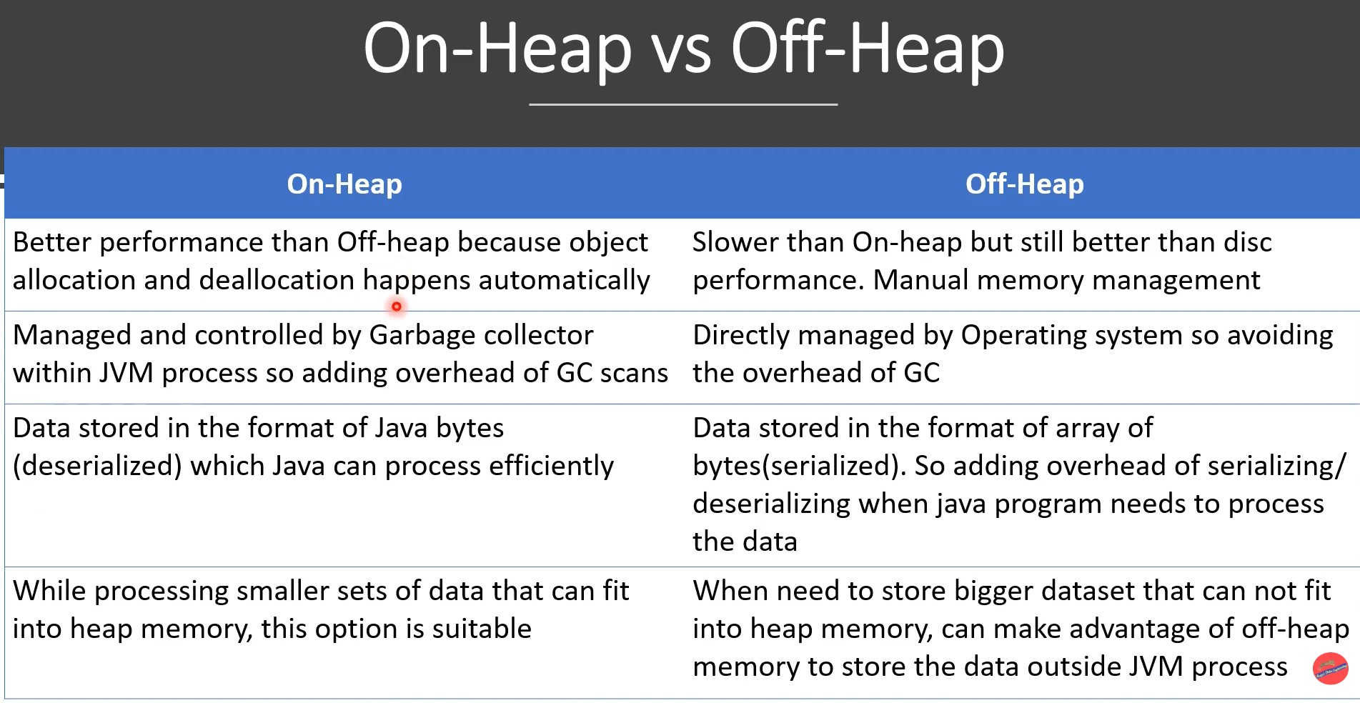

Slide 35
Summary – Best Practices
Tune spark.memory.fraction and storageFraction as per workload ✅ Use off-heap memory for large datasets and stable caching ✅ Monitor and minimize GC using Spark UI ✅ Allocate enough memoryOverhead for spill-heavy operations (joins, wide transformations)

Slide 36
c. Memory Regions
Execution memory: Used for shuffles, joins, aggregations
Storage memory: Caching and broadcasting
User memory: JVM overhead
d. When to Use Off-heap Memory
Large datasets, avoid GC overhead
Use with spark.memory.offHeap.enabled = true

Slide 37
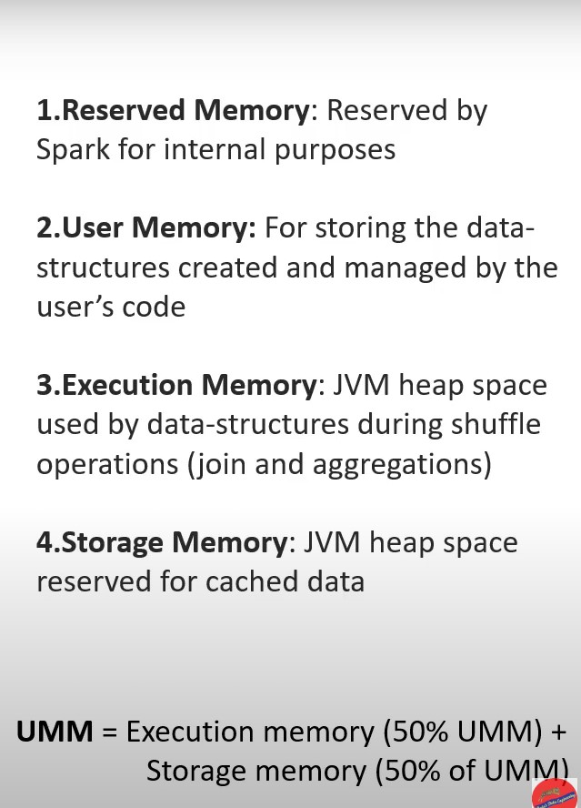

Slide 38
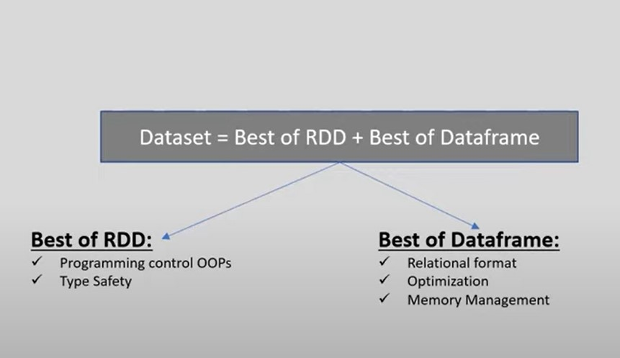

Slide 39
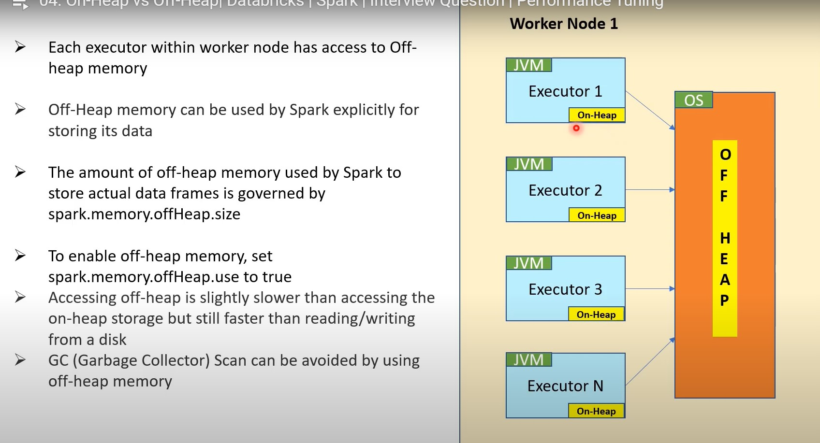

Slide 40
RDDs – The Foundation of Spark
a. What are RDDs?
Resilient Distributed Datasets (low-level, fault-tolerant collections)
Immutable, distributed collections of objects

Slide 41
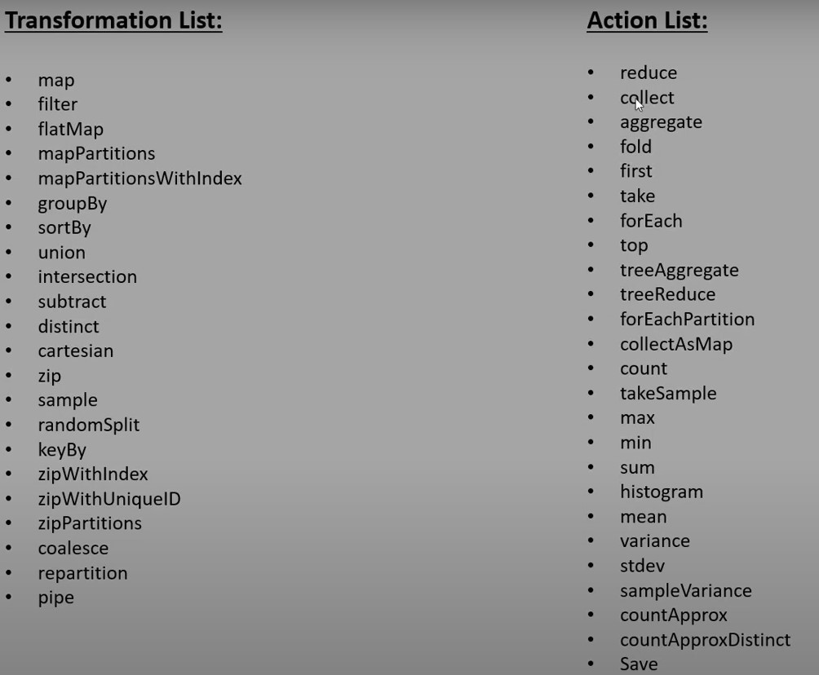

Slide 42
b. When to Use RDDs
Use Case | Why
Fine-grained control | Custom partitioning, low-level operations
No need for schema | Unstructured or complex data
Transformation-heavy workflows | Complex logic not suited for SQL/DataFrame

Slide 43
c. Why Avoid RDDs (for most DE work)?
No optimization (no Catalyst/Tungsten)
Manual memory tuning
Verbose syntax
Lack of schema-awareness

Slide 44
PySpark DataFrame API – The Recommended Approach
What is a DataFrame in PySpark?
Tabular data structure with schema
Built on RDD but optimizable
Supports SQL operations, aggregation, joins, etc.

Slide 45
Why Use DataFrames?
Optimized via Catalyst optimizer
Execution engine benefits from Tungsten (off-heap memory, bytecode gen)
Declarative (write less, get more)

Slide 46
Comparison: PySpark DataFrame API vs Pandas API on Spark
a. What is Pandas API on Spark?
Use Pandas-like syntax over Spark DataFrames
Good for users transitioning from Pandas

Slide 47
b. When to Use Pandas-on-Spark?
Use Case | Why
Transitioning from Pandas | Minimal code changes
Exploratory analysis | Quick interactive work
Data Science notebooks | Familiarity over performance

Slide 48
Why Data Engineers Should Prefer DataFrame API
Factor | PySpark DataFrames | Pandas-on-Spark
Performance | ✅ Catalyst & Tungsten | ⚠️ Slower due to abstraction
Optimization | ✅ Fully optimized | ❌ Limited tuning
Control over resources | ✅ Executor-level configs | ⚠️ Less visibility
Production-grade ETL | ✅ Industry standard | ❌ Not preferred
Compatibility | ✅ All Spark APIs | ⚠️ Some features missing

Slide 49
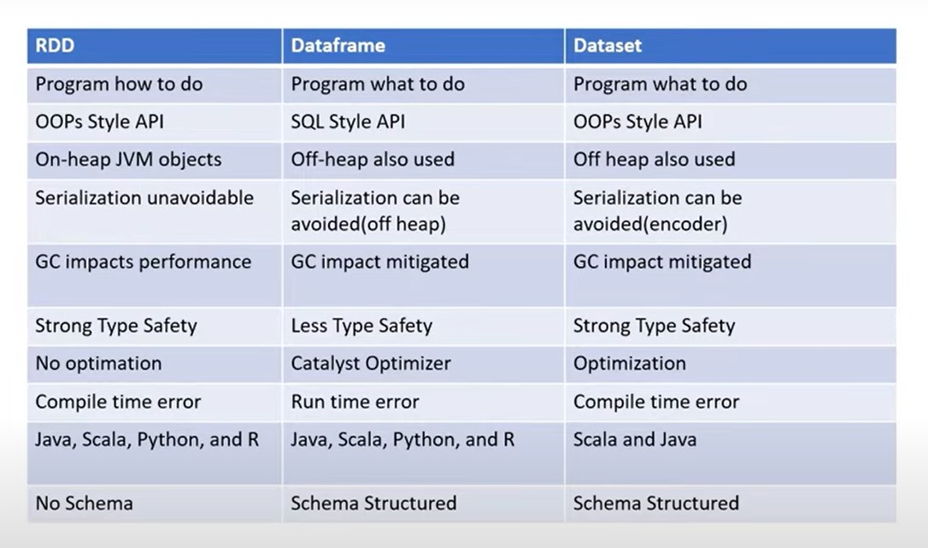

Slide 50
✅ 1. UDFs (User Defined Functions)
👉 When to use:
You need custom logic not available in built-in Spark SQL functions.
Be careful! UDFs are slower because they run row-by-row and break Spark’s optimization (no predicate pushdown, no vectorization).

Slide 51
# This supports pushdown
df.filter("age > 30").explain()
# This does NOT
df.filter(my_custom_udf("age")).explain()

Slide 52
No Vectorization = Row-by-Row Processing
What is vectorization? Processing data in batches (column-wise) instead of row-by-row.
Built-in functions use Java bytecode + columnar format, which is fast.
UDFs execute Python code one row at a time = expensive Python-Java crossing = slow.

Slide 53
pandas_udf: Faster UDF Alternative
from pyspark.sql.functions import pandas_udf
import pandas as pd
@pandas_udf("string")
def label_even_odd(s: pd.Series) -> pd.Series:
return s.apply(lambda x: "even" if x % 2 == 0 else "odd")
df.withColumn("label", label_even_odd(df["value"])).show()

Slide 54
Serialization and UDFs
Serialization = converting objects into bytes to send them across processes (Python ↔ JVM).
Spark uses:
Java Serialization (default): slow, verbose
Kryo Serialization (faster): compact, recommended for performance
spark.conf.set("spark.serializer", "org.apache.spark.serializer.KryoSerializer")

Slide 55
UDFs add extra serialization overhead:
Data must be converted from JVM (Spark) to Python (UDF) and back.
This marshalling adds cost.

Slide 56
Partitions
Why partition matters:
Spark runs tasks per partition.
More partitions = more parallelism.
Too many = overhead; too few = underutilization.

Slide 57
Caching vs. Persisting
🔸 What is Caching?
Caching stores RDD/DataFrame in memory (RAM) for faster reuse in iterative or multiple actions.
Example: If you perform multiple actions (like count(), show()), Spark will re-evaluate the plan unless cached.

Slide 58
Feature | cache() | persist()
Storage | Memory only | Memory + Disk (or custom level)
Default | MEMORY_AND_DISK | Needs level specification
Fault Tolerant | Partial | More options

Slide 59
df_cached = df2.cache()
df_cached.count()
Note:
Use .unpersist() after use to free memory.
Don’t over-cache; cache only reused large dataframes.

Slide 60
Serialization in Spark
Serialization is how Spark converts objects to bytes for storage/shuffle/execution.
Type | Description | Performance
Java Serialization | Default, works for any object | Slow
Kryo Serialization | Faster, compact, needs registration | Fast

Slide 61
Serialization affects shuffle performance and memory usage.
Kryo is a must for large datasets or ML workflows.

Slide 62
cache() keeps data in memory; persist() allows memory/disk levels.
Always unpersist unused dataframes.
Prefer Spark built-in functions over UDFs.
Serialization impacts shuffle & memory. Kryo is faster.
Use Spark UI and event logs to debug performance.

Slide 63
Performance Bottlenecks in Spark Jobs
Skewed Joins
One side of a join has disproportionately large partitions.
Causes a few tasks to run very long, leading to stage delay.
Diagnosis:
Uneven task duration in Spark UI.
High shuffle read size for specific tasks.

Slide 64
✅ 2. Shuffle Spill to Disk
What is Shuffle?
Intermediate data exchange during groupBy, join, distinct, etc.
🔸 Why Spills Happen?
When data exceeds executor memory, it spills to disk — slower I/O.
🛠️ Tips:
Increase memory: spark.executor.memory
Tune partitions: spark.sql.shuffle.partitions
Use Broadcast Join for small tables.

Slide 65
Broadcast Joins
What It Is:
Small DataFrame is sent to all executors to avoid shuffle.

Slide 66
Predicate Pushdown & Data Pruning
Definition:
Filter conditions pushed to data source layer, reducing I/O.
✅ Works with:
Parquet, ORC, Delta
❌ Not with:
CSV, UDF-based filters

Slide 67
Summary : Common fix
Issue | Fix
Skewed data | Salting, repartition
Shuffle spill | Tune memory, broadcast small joins
Too many small files | Use coalesce, enable autoCompact in Delta
UDF bottleneck | Replace with built-in functions
Predicate not pushed | Avoid UDFs in filters, use Parquet/Delta

Slide 68
What Is Structured Streaming?
Structured Streaming is Spark’s stream-processing engine built on top of the Spark SQL engine. It lets you write batch-like code that works with real-time data streams.
🔁 Think of it as continuously running a query on incoming data!

Slide 69
Concept | Description
Input Source | Where your data comes from (e.g., Kafka, files, sockets, Event Hub)
Output Sink | Where your results go (e.g., console, files, Delta, memory)
Trigger | How frequently Spark processes the stream
Checkpointing | Saves stream progress (offsets) so it can recover on restart
Watermarking | Handles late data with event time windows

Slide 70
⚙️ Micro-Batch Model (NOT Row-by-Row)
Structured Streaming works in micro-batches:
It picks a batch interval (e.g., every 10 sec),
Processes all new data since last batch,
Updates results and writes to the sink.
⚠️ Internally, it uses Spark jobs per batch — not truly row-level streaming.

Slide 71
🔁 Event Time vs Processing Time
Type | Meaning
Event Time | When the event actually happened (inside the data)
Processing Time | When Spark receives and processes the data
→ Event time + watermarking is important for accurate aggregations.

Slide 72
Parquet File Format
A columnar storage format optimized for large-scale queries.
Efficient for read-heavy workloads — only read required columns.
Supports predicate pushdown, compression, and schema evolution (to some extent).

Slide 73
Key Advantages:
Efficient compression: Similar data in each column → better compression.
Columnar I/O: Only reads relevant columns.
Predicate Pushdown: Filters are pushed to file scan stage.
Native support by Spark, Hive, Presto, etc.

Slide 74
🔸 Delta Lake Format
Delta Lake is built on top of Parquet with added capabilities.
What is Delta?
Storage layer + transaction log that brings ACID transactions to data lakes.
Built on Parquet, but with .delta format.
Enables Insert, Update, Merge, Schema Evolution, Time Travel, VACUUM, and OPTIMIZE.

Slide 75
✅ Why Delta Over Parquet:
Feature | Parquet | Delta Lake ✅
ACID Transactions | ❌ | ✅
Schema Evolution | ❌ (Limited) | ✅
Time Travel | ❌ | ✅
MERGE support | ❌ | ✅
Upsert/Delete | ❌ | ✅
Streaming Support | ✅ | ✅
Performance Optimizations | ✅ | ✅ + ZORDER

Slide 76
UPSERT (MERGE) – Update + Insert
"If a record exists → Update it. If it doesn't → Insert it.“
Schema Evolution → allows new columns to be added to existing Delta tables automatically
Time Travel
Delta automatically versions your table using transaction logs. You can go back in time to view or restore older data.

Slide 77
ACID Transactions
Delta uses a transaction log (_delta_log/) to ensure atomicity, consistency, isolation, and durability.
Multiple users can read/write safely
Prevents partial writes or corrupt states
Like a mini-database on a data lake

Slide 78
VACUUM – File Cleanup
Deletes old, unreferenced Parquet files after a retention period.
delta_table.vacuum(168) # Clean files older than 168 hours (7 days)
Helps free up storage
Retains files for time travel unless retention is changed

Slide 79
✅ 6. OPTIMIZE + ZORDER
Improves read performance by compacting small files and organizing data.
OPTIMIZE delta.`/path/to/table`
ZORDER BY (customer_id)
📝 ZORDER = Co-locates data for faster queries (like indexing)

Slide 80
Introduction to Databricks and Azure Databricks
Unified Analytics Platform for Big Data and AI

Slide 81
What is Databricks?
Databricks is a cloud-based platform for data engineering, data science, and machine learning.
Built on Apache Spark, it provides:
Unified analytics workspace
Managed infrastructure and compute clusters
Collaborative notebooks
Supports multiple languages: Python, SQL, Scala, R

Slide 82
What is Azure Databricks?
Azure Databricks is a unified, cloud-native platform for big data engineering, data science, analytics, and AI/ML.
It's a first-party Azure service, co-developed by Microsoft and Databricks, offering:
Fully managed Apache Spark
Built-in collaborative notebooks
Powerful Delta Lake support
Native integration with Azure services like ADLS, ADF, Key Vault, Synapse, Purview, and more.

Slide 83
Core Components
Component | Description
Workspace | Collaborative environment with notebooks, dashboards, and libraries
Clusters | Autoscaling Spark clusters that run your jobs, notebooks, and jobs
Notebooks | Interactive web-based code editors supporting Python, Scala, SQL, R
Jobs | Scheduled or triggered execution of notebooks or workflows
Delta Lake | Storage layer enabling ACID transactions, schema enforcement, and time travel
Unity Catalog | Centralized governance, metadata, and security for data assets across workspaces
Databricks SQL Warehouses | Optimized compute for fast SQL queries, powered by the Photon engine
MLflow | End-to-end machine learning lifecycle management, integrated with Databricks
Delta Live Tables | Declarative ETL pipelines with built-in quality checks and incremental processing

Slide 84
Databricks Runtime (DBR)
Optimized Spark distribution maintained by Databricks.
Includes enhanced libraries for:
SQL analytics (Photon)
Machine learning (MLflow, XGBoost)
Structured Streaming
Delta Lake enhancements

Slide 85
Cluster Types
Interactive Clusters: For exploratory data analysis and development.
Job Clusters: Created and terminated automatically for scheduled jobs.
High Concurrency Clusters: Shared by multiple users with isolation and resource controls.

Slide 86
Storage & File System Integration
DBFS (Databricks File System): Distributed file system abstraction over cloud storage.
Direct integration with Azure Data Lake Storage Gen2 (ADLS Gen2) using abfss:// protocol.
Support for mounting external storage accounts securely.

Slide 87
Notebooks & Collaboration
Support multiple languages in one notebook with magic commands (%python, %sql, %scala).
Real-time collaboration with commenting, revision history, and version control integration.
Integrated visualization tools for charts and dashboards.

Slide 88
Jobs and Workflows
Define complex pipelines with dependencies using task graphs.
Schedule jobs using cron syntax or event triggers.
Supports alerting and monitoring via Azure Monitor integration.

Slide 89
Security & Governance
Integration with Azure Active Directory (AAD) for authentication.
Role-based access control (RBAC) for clusters, jobs, and data.
Network security with VNET injection and Private Link support.

Slide 90
Unity Catalog: Centralized Governance in Databricks
Unity Catalog is Databricks’ unified governance layer that provides:
Centralized metadata management
Fine-grained access control (RBAC) down to columns, views, and functions
Audit logging, lineage tracking, and cross-workspace visibility

Slide 91
Why Use Unity Catalog?
Previously, permissions and metadata were tied to individual workspaces and clusters.
With Unity Catalog, governance is decoupled from compute:
Create one metastore and manage multiple workspaces centrally
Enforce data security and compliance (GDPR, SOC2, etc.)
Track data lineage from ingestion to BI or ML

Slide 92
Unity Catalog Hierarchy
Metastore
└── Catalog (e.g., 'main_catalog')
└── Schema (e.g., 'sales_schema')
└── Table/View/Function (e.g., 'sales_2024')

Slide 93
Key features
Feature | Benefit
Column-level access control | Enforce policies at the most granular level
Lineage tracking | Visualize where and how data is used
Centralized RBAC | Consistent access policies across teams
Multi-workspace governance | Manage data across different teams or regions
Audit logs | Track who accessed or modified data

Slide 94
What is a Lakehouse?
A Lakehouse is a unified data platform that merges the low-cost, large-scale storage of a data lake with the structured data management and performance of a data warehouse.
Enables analytics, streaming, BI, and machine learning — all from a single copy of data.
Core to Databricks — powered by Delta Lake and supports open formats like Parquet.

Slide 95
Feature | Data Lake | Data Warehouse | Lakehouse (Databricks)
Schema Enforcement | No | Yes | Yes (Delta Lake)
Supports ML/Streaming | Difficult | No | Yes
Data Format | Parquet, Avro, JSON, CSV | Proprietary (e.g., SQL Server) | Open (Parquet + Delta log)
Performance Optimization | None | Yes | Yes

Slide 96
Components That Enable the Lakehouse
Delta Lake: Core format enabling lakehouse capabilities
Unity Catalog: Governance, access control, and lineage
SQL Warehouses (Photon): High-speed BI/SQL layer
Delta Live Tables: Declarative ETL pipelines for clean Silver/Gold layers
MLflow: Model tracking and deployment directly on top of lakehouse data

Slide 97
Where is the Lakehouse in Databricks?
The Lakehouse is the core architecture of Databricks. Here's how:
Storage Layer → Built on cloud object stores (e.g., ADLS in Azure)
Data Format → Uses Delta Lake (brings ACID, schema evolution, etc.)
Processing Layer → Powered by Apache Spark, Photon, and DLT
Governance Layer → Unity Catalog for metadata, security, and lineage
Consumption Layer → BI tools (Power BI), ML models, or Dashboards

Slide 98
What “concurrency” means
Concurrency means:
Multiple users, jobs, or processes accessing or modifying the same table at the same time.
Examples:
Two ETL jobs writing to the same table
One job updating data while another job reads it
A dashboard query running while ingestion is happening
Concurrency is normal in real systems — not an edge case.

Slide 99
Why concurrency is a problem in data lakes
Traditional data lakes use:
Parquet files
Object storage (ADLS / S3)
No locking
No transactions
What goes wrong without concurrency control
If two Spark jobs do this at the same time:
Job A writes part-001.parquet
Job B writes part-001.parquet

Slide 100
Possible outcomes:
Data corruption
Partial writes
Readers see half-written data
Silent data loss
This is why plain Parquet is not safe for concurrent writes

Slide 101
Delta Lake’s core idea for concurrency
Delta Lake introduces transactional semantics on top of object storage.
The key idea:
No writer ever modifies data files directly. Writers only commit changes through the transaction log.
This log is the single source of truth.

Slide 102
Optimistic Concurrency Control (the key term)
Delta Lake uses optimistic concurrency control, not locking.
What “optimistic” means
Assume conflicts are rare
Allow multiple writers to proceed in parallel
Detect conflicts only at commit time
This is different from pessimistic locking, where:
One writer blocks everyone else

Slide 103
Step-by-step: Two writers at the same time
Let’s say the table is currently at version 10.
🧩 Step 1: Both writers read the same snapshot
Job A reads version 10
Job B reads version 10
They both see the same consistent view of the table.
🧩 Step 2: Both writers compute changes independently
Job A prepares new Parquet files (but doesn’t expose them yet)
Job B prepares its own Parquet files
At this point:
No data is visible to readers
No corruption is possible

Slide 104
🧩 Step 3: Job A tries to commit
Job A writes a new JSON file:
00000000000000000011.json
This commit says:
“Remove these old files”
“Add these new files”
Commit succeeds
Table is now at version 11
This commit is atomic.

Slide 105
🧩 Step 4: Job B tries to commit
Job B says:
“I want to commit changes based on version 10.”
Delta Lake checks:
Is version 10 still the latest version? ❌ No
Now Delta performs conflict detection.

Slide 106
Conflict detection (the critical part)
Delta checks:
Did Job B modify files that were also modified by Job A?
Did schema or metadata change?
Possible outcomes:
✅ No conflict
Job B’s changes touch different rows/files
Delta rebases and commits Job B as version 12
❌ Conflict detected
Both jobs modified overlapping data
Job B fails with a concurrent modification exception
Job B must retry
No silent corruption ever occurs

Slide 107
What readers see during all this
This is snapshot isolation.
Readers:
Always read the latest committed version
Never see:
Half-written files
Partial updates
Inconsistent rows
Even while jobs are writing:
Readers see version 10, then 11, then 12
Never an in-between state
This is what Isolation means in ACID.

Slide 108
How this compares to databases
Aspect | Traditional DB | Delta Lake
Storage | Pages | Files
Concurrency | Locks | Optimistic
Isolation | Lock-based | Snapshot-based
Rollback | Undo logs | Log replay
Readers blocked? | Sometimes | Never

Slide 109
Delta Live Tables (DLT) – Simplifying ETL in Lakehouse
Delta Live Tables (DLT) is a declarative framework in Databricks to build reliable, automated data pipelines. Instead of writing imperative code for each transformation, you declare what each table should do — DLT handles the rest.

Slide 110
Why use DLT?
Traditional ETL | With Delta Live Tables
Manual orchestration | Built-in dependency handling
Reprocessing complexity | Incremental by default
Hard to enforce quality | Data expectations built-in
Manual recovery | Automatic retries & checkpoints

Slide 111
How DLT Works
DLT runs on Databricks Jobs infrastructure, using a pipeline definition with SQL or Python decorators.
Each transformation is either:
@dlt.table: A materialized (persisted) table
@dlt.view: A logical (non-materialized) view

Slide 112
Key Features
✅ Declarative Syntax (Python/SQL)
✅ Auto-manages dependencies
✅ Incremental processing
✅ Built-in quality checks
✅ Visual UI for pipeline monitoring
✅ Retry logic, logging, and version control

Slide 113
Data Quality with Expectations
DLT supports data expectations similar to unit tests.
If records fail, they are either dropped or quarantined based on settings.
You can monitor violations in the UI dashboard.

Slide 114
What is Medallion Architecture?
The Medallion Architecture is a layered design pattern that organizes data in multiple refinement stages:
Layer | Purpose | Format
Bronze | Raw ingestion, append-only | JSON, CSV, Delta
Silver | Cleaned, joined, enriched | Delta
Gold | Aggregated, business-ready tables | Delta

Slide 115
Legacy Approach: Mounting with Service Principal
[Databricks Notebook]
|
v
Uses `dbutils.fs.mount()`
|
v
[Service Principal] --> [ADLS Gen2 Storage Account]
(client ID + secret)
|
v
Creates Mount Point:
/mnt/mydata/
|
v
Reads File Like:
spark.read.csv("/mnt/mydata/file.csv")

Slide 116
Limitations
Secrets exposed in code or cluster configs
Mounts are shared across users
No native catalog or governance
Poor discoverability

Slide 117
Modern Approach: Unity Catalog + External Location (No Mount)
[Databricks Notebook]
|
v
Accesses data via `abfss://container@account.dfs.core.windows.net/...`
|
v
[Unity Catalog]
|
├── External Location (points to ADLS2)
├── Managed by Metastore Admin
└── Fine-grained permissions
|
v
[ADLS Gen2 Storage Account]
(Access via credential passthrough or managed identity)
|
v
Reads Table Like:
SELECT * FROM catalog.schema.table

Slide 118
Benefits
No secrets in code
Per-user access control
Full data lineage, auditing, discovery
Tables visible in Catalog tab

Slide 119
Feature | Mounting (Legacy) | Unity Catalog (Modern)
Access method | /mnt/... | abfss://... / SQL
Authentication | Service Principal | Passthrough / Managed ID
Security scope | All users share mount | Per-user, role-based
Catalog/governance | ❌ None | ✅ Unity Catalog
Auditing | ❌ Manual or external | ✅ Built-in
Recommended for new projects? | ❌ No | ✅ Yes

Slide 120
Summary
DLT makes production-ready pipelines easy to write, monitor, and scale
It fits natively into the Lakehouse via Delta, ADLS, Unity Catalog, and Spark
Ideal for Bronze → Silver → Gold transformations

Slide 121
Auto Loader in Databricks – Scalable Data Ingestion
Auto Loader is a Databricks-managed feature that automatically detects and ingests new files from cloud storage into Delta Lake tables efficiently.
It is ideal for ingesting incremental data into the Bronze Layer of the Medallion Architecture.

